Slide 1

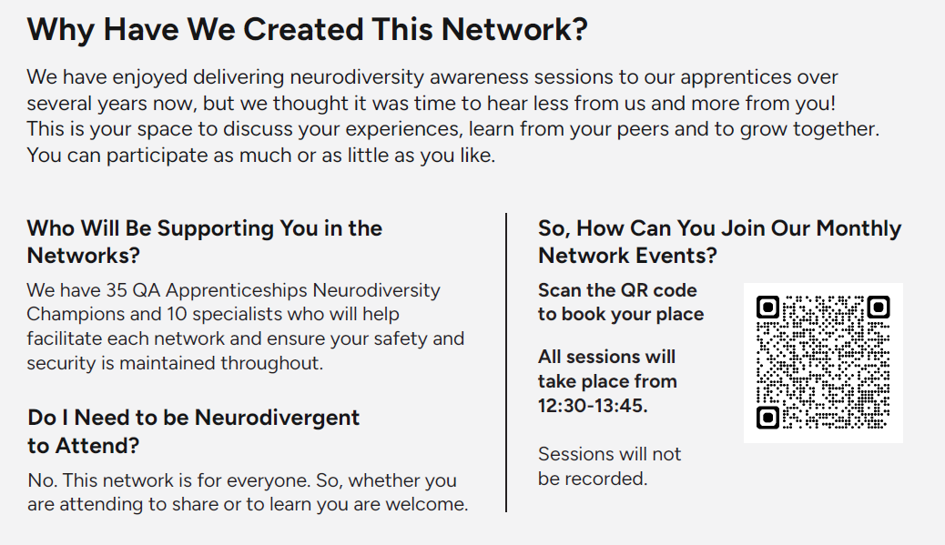
QA Apprenticeship Neurodiversity Network – book here
This is your space to share, learn and discuss all things neurodiversity.
There are 4 networks:
The 3Ds – Dyslexia, Dyspraxia, & Dyscalculia
Autism & ADHD
Parents’ Corner
Ask the Specialist

Slide 2
QA Apprenticeship Neurodiversity Network – book here
Date | Session Topic
16th July | Tired or Toasted? How Do You Know When It’s Burnout? This session aims to explore the difference between everyday fatigue and true burnout — helping you spot the early warning signs and take action before it spirals. By understanding what burnout really looks like, we can better protect both our personal well-being and the health of our organisations.
20th August | Office or Obstacle Course? Rethinking Work for Neurodiverse Minds In this session we will discuss how neurodiversity impacts us in the workplace. We'll explore the barriers neurodivergent employees face and how organisational culture around neurodiversity shapes our experiences.
17th September | Nurturing Wellbeing in a Neurodiverse World Explore how neurodiversity intersects with mental health, uncovering the unique challenges and strengths of neurodivergent individuals. Join us to share insights, coping strategies, and experiences that promote wellbeing in a neurodiverse world.

Slide 3
QA Apprenticeship Neurodiversity Network – book here
Date | Session Topic
15th October | Hormones in Motion: The Neurodivergent Experience This discussion will explore how hormonal fluctuations—such as those occurring during menstruation, pregnancy, and menopause—impact individuals with neurodivergent conditions. We will examine the interplay between hormonal changes and neurodivergent traits, focusing on emotional regulation, sensory processing, and executive function.
19th November | Mind the Message: Verbal and Written Communication in a Neurodiverse World Join us for a discussion on how verbal and written communication styles affect neurodiverse individuals. We'll explore real-world experiences and practical strategies for making communication more inclusive, flexible, and effective for all minds.
17th December | Who do you think you are? In this session, we’ll explore how neurodiversity shapes the way we experience the world and express our authentic selves. We’ll look at how our different ways of thinking affect how we present to and connect with others, and succeed in life and work.

